Slide 1
2013-2022 Full Presentation
Orientation Packet
for those new to DPCAC Emissions Report
and a refresher for others
Fall 2024

Slide 2
What’s in the Orientation Packet
Emissions, Air Quality and Health 3
Why Review Emissions Reports 4
Where Emissions Come From 5
Where Data Come From 12
Where Numbers Come From 18
Acronyms, Terms, and Descriptions 26
For More Information 34
Pounds

Slide 3
Emissions, Air Quality and Health
Emissions, Air Quality and Health
Emissions come from many sources, including industry
Minimizing emissions improves air quality, which is good for health and the environment
Report focuses on emissions from DPCAC plants
Other meetings may focus on air quality trends and on health data and research
Pounds

Slide 4
WHY EMISSIONS REPORTS?
Learn what DPCAC plants release to air, land, and water
Including pollutants contributing to ozone
Help public learn about chemicals in the community
Plants may learn from their own reports and others
Allows us to track trends, though trends are affected by changing circumstances
If you can measure it, you can manage it
Pounds

Slide 5
Where Emissions Come From

Slide 6
Source of Air Pollution
All Air Pollutants
Industry/ Plants
Transportation
Biogenic
TCEQ Air Emissions Inventory (EI)
EPA
TRI-Air
Agriculture
Residential Heating & Cooking
Not to scale

Slide 7
Two Kinds of Air Emissions
Point sources
Fugitive sources- may occur at connections
Pounds

Slide 8
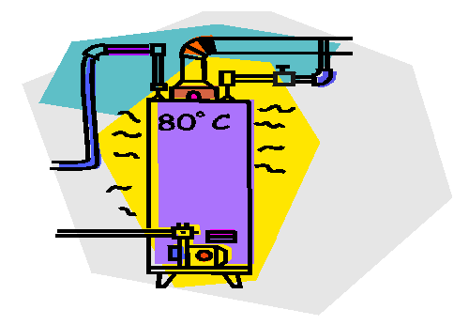
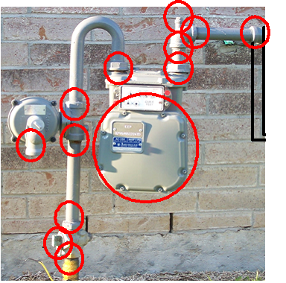
Point Source vs. Fugitive Emission Sources
Point Source
Fugitive Emissions
CO
NO_{X}
VOC
SO_{X}
Gas Meter
13 fugitive sources
Pounds

Slide 9
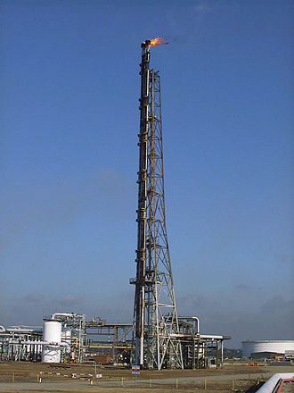
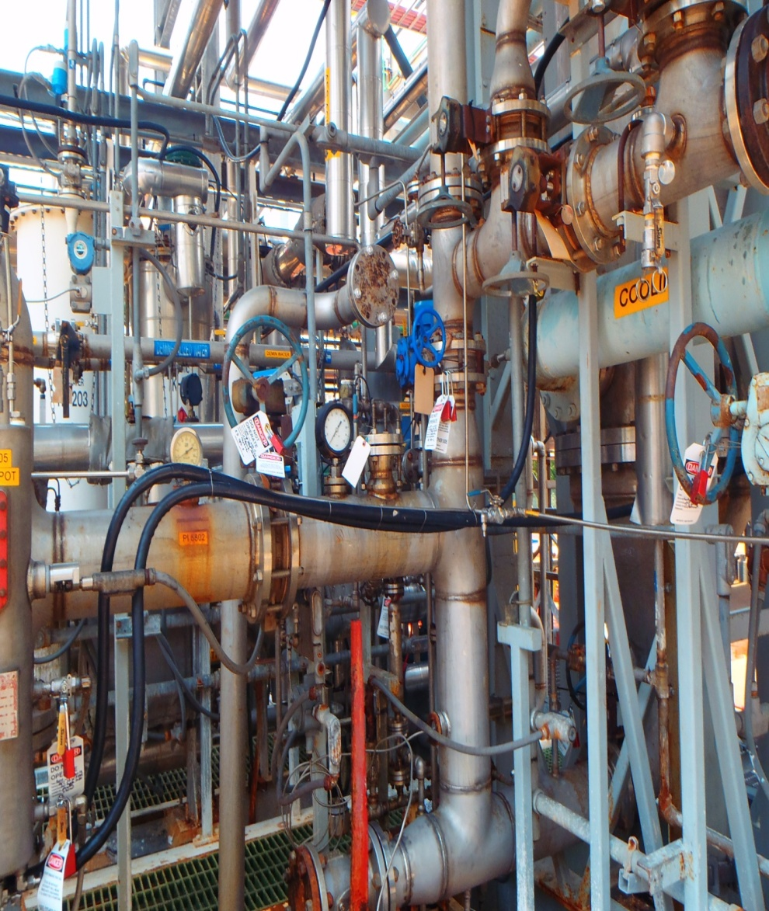
Point Source vs. Fugitive Emission Sources
Point Source
Fugitive Emissions
Pounds

Slide 10
Plant Sources of Air Emissions
From:
During:
Boilers
Heaters
Cooling towers
Process vents
Tanks
Wastewater treatment
Routine permitted activities, including maintenance startup, and shutdown
Loading and unloading of trucks and trains
Upsets
Spills
Pounds
NOx comes mostly from combustion in heaters and boilers.
VOCs come from many sources.

Slide 11
Things DPCAC Plants Make or Do
That Generate Emissions
Refine crude oil: PEMEX Deer Park
Manufacturer chemicals: Dow, Evonik, GEO, Lubrizol, NOVVI, OxyChem, Shell Deer Park Chemicals, Westlake Epoxy
Package and distribute lubricants: Valvoline
Store and ship other plants’ products: ITC, Vopak Exolum , Vopak Terminal Deer Park
Manage waste or wastewater from other plants: Clean Harbors, Texas Molecular
Pounds

Slide 12
Where Data Come From

Slide 13
2024 DPCAC Emissions Report Files
Reported annually by major sources to Texas Commission on Environmental Quality (TCEQ)
Just air -- all air releases of covered pollutants
TCEQ Emissions Inventory
Reported annually to Environmental Protection Agency (EPA) by plants in certain kinds of business if plant has chemicals on TRI list above a set amount.
Releases to environment (air, land, water) and transfers off the plant site for further waste treatment and disposal
EPA Toxics Release Inventory

Slide 14
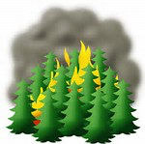
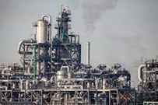
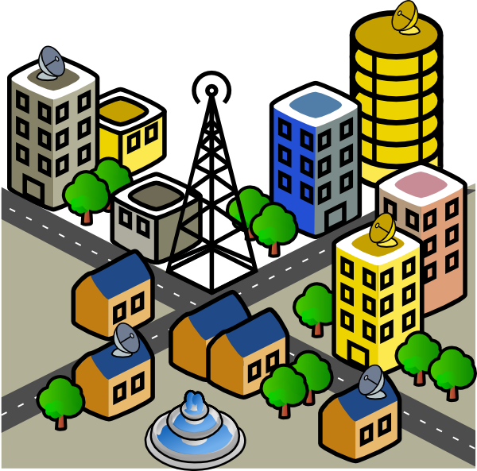
Industry Reporting of Air Emissions
TCEQ Air Emissions Inventory (EI)
EI and TRI Overlap
EPA Toxics Release Inventory (TRI-Air)
All Air Pollutants
(Point + Area + Mobile + Natural)
Not to scale
14

Slide 15
Comparing EI vs. TRI
Air Emissions Inventory (EI)
Toxics Release Inventory (TRI)
State requirements (TCEQ)
Contaminants released to Air
Required for permitting and compliance
Almost all air contaminants (even small quantities)
Federal Requirement (EPA)
Contaminants released to air, water, and land
Required for public right-to-know
Approx. 820 chemicals that exceed specific thresholds
Pounds
Both Reports
Include point source and fugitive emission values.
Calculation methods including direct measurements, engineering estimates, and agency factors
Include permitted and upset emissions
Can show useful trends
Small facilities are exempted

Slide 16
Requirements for TCEQ EI Reporting
A plant must submit an EI if it meets any one of the following
Major Source
In Harris County and emits at least 10 tons per year (TPY) VOCs, 25 TPY NOx, or 100 TPY of any other contaminant
Emits more than 0.5 TPY of lead (Pb)
Potential to emit 10 TYP of a single (25 TPY aggregate) hazardous air pollutant
Subject to a special inventory
Pounds

Slide 17
Requirements for EPA TRI Reporting
Plants must report if:
the chemicals used in their processes are covered by the TRI program (approximately 820 chemicals)
the plant makes more than 25,000 lbs. of a TRI chemical in a year
the plant uses more than 10,000 lbs. of the TRI chemical in a year
they have much smaller quantities of certain TRI chemicals
Pounds

Slide 18
Where Numbers Come From

Slide 19
Where Numbers Come From
Measurements from Continuous Emissions Monitoring Systems (CEMS), stack and vent tests, lab analysis, and other direct measurements
Estimates from calculations based on fuel consumption, mass balance of process, engineering calculations, throughput formulas, flow measurements, inventory loss, production data, and field surveys
Fugitives often estimated by EPA’s AP-42 factors
Direct measurements may be incorporated into calculations
Changing calculation methods
Improves accuracy
Affects emissions numbers positively or negatively
Pounds

Slide 20
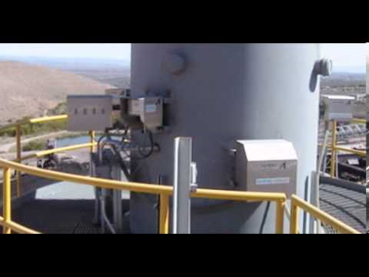
Measurements Continuous Emission Monitoring System (CEMS)
Only available for certain kinds of emissions
Most accurate way to quantify emissions
….and the most expensive to install & maintain
20

Slide 21
Emissions Measurement Example
NOx emissions calculations basis
NOx and CO CEMS data (concentration, ppmvd)
Exhaust gas flow rate (dscfm)
Molecular weight (lb/lb-mol)
Boiler NOx example:
C ppmvd * MW lb/lb-mol * Q dscfm * 60 min/hr = lb/hr
Videal gas, cf/lb-mol * 10⁶
17.86 * 46.1 * 19,150 * 60 = 2.45 lb/hr NOx
386.5 * 10⁶

Slide 22
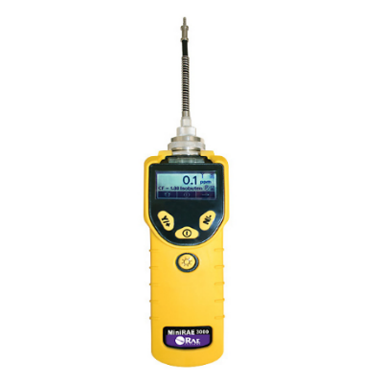
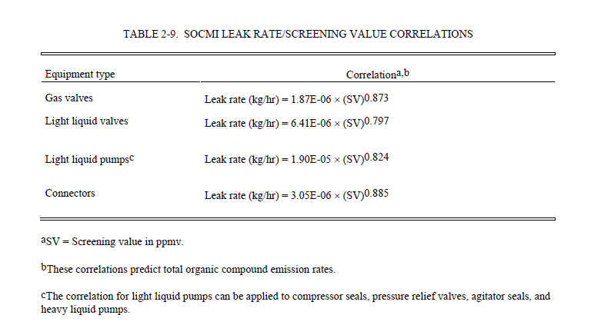
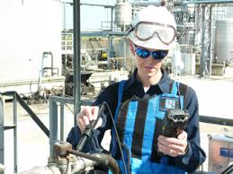
Measurement + Calculation
Fugitive VOC emissions calculation basis
EPA Test Method 21 monitoring results
EPA/TCEQ correlation equations
Annual Leak Report

Slide 23
Published Emission Factors
Emission factors are continuously revised and added!

Slide 24
Emission Factor Example

Slide 25
Factors Causing Year-to-Year Variations
Actual long-term changes in emissions
Plant or unit start-ups or shutdowns
Pollution prevention efforts – practices/equipment
Making different products from year to year
Production/customer demand - up or down
Maintenance and related shutdowns and startups
Changing number of plants in DPCAC
Changing calculation methods
Upsets, leaks and spills
Weather

Slide 26
Emissions and Air Monitoring Acronyms and Terms

Slide 27
Common Acronyms
Agencies
Criteria Pollutants/ Precursors
EPA – US Environmental Protection Agency
TCEQ – Texas Commission on Environmental Quality
NOx –Nitrogen Oxides
VOCs – Volatile Organic Compounds
HRVOC – Highly Reactive Volatile Organic Compounds
SOx –Sulfur Oxides
TSP – Total Suspended Particulates
CO – Carbon monoxide
Pounds
Inventories
EI – TCEQ Air Emissions Inventory
TRI – EPA Toxics Release Inventory
Other
TAR – Turnaround
HYCO – Hydrogen, Carbon Monoxide (components of Syngas)

Slide 28
Emissions & Air Monitoring Acronyms & Terms
EI- Emissions Inventory filed with TCEQ for all criteria pollutants (and their precursors) and hazardous air pollutants, such as benzene and 1,3-butadiene.
TRI- Toxics Release Inventory, filed with EPA
Emission: Pollution discharged into the atmosphere from smokestacks, other vents, and surface areas of commercial or industrial facilities; from residential chimneys; and from motor vehicle, locomotive, or aircraft exhausts. (EPA)
Release- Any spilling, leaking, pumping, pouring, emitting, emptying, discharging, injecting, escaping, leaching, dumping, or disposing into the environment of a hazardous or toxic chemical or extremely hazardous substance. (EPA)
Environment- Air, water, groundwater, and land.

Slide 29
Emissions & Air Monitoring Acronyms & Terms
LDAR- Leak Detection and Repair. Fugitive emissions are controlled by looking for leaks and fixing them. See gas meter (fugitives) vs. hot water heater (point sources).
DOR- Delay of Repair is a common cause of fugitive emission increases when leaking component cannot be repaired without shutting down plant. More emissions would result from the shutdown than from delaying repair. Components can also placed on DOR if it would be unsafe to attempt repair with chemicals in the process piping or equipment.
TPY- Tons Per Year

Slide 30
Emissions & Air Monitoring Acronyms & Terms
Criteria Pollutants and Precursors
Ozone- Respiratory irritant that may form in the atmosphere when NOx and VOCs come together on still, sunny days.
NOx- Nitrogen Oxides. Nitrogen dioxide and other gases made of varying mixtures of nitrogen and oxygen. Formed when fuel is burned at high temperatures. (EPA)
VOCs- Volatile Organic Compounds. Volatiles evaporate rapidly. Organic Chemicals or Compounds are naturally occurring (animal or plant-produced) or synthetic substances containing mainly carbon, hydrogen, nitrogen, and oxygen. VOCs are any organic compounds that participate in atmospheric photochemical reactions except those designated by EPA as having negligible photochemical reactivity. (EPA). Photochemical reactions are influenced or initiated by light. There are hundreds of VOCs, including common ones like ethylene, propylene, benzene, and formaldehyde. VOCs are found in many household products and are thus an indoor air quality interest.
FGRS- flare gas recovery system
MSS- maintenance, shut down and startup
RTO- regenerative thermal oxidizer to reduce emissions to the atmosphere
TO- thermal oxidizer
WWT- wastewater treatment
WWTP- wastewater treatment plant

Slide 31
Emissions & Air Monitoring Acronyms & Terms
Criteria Pollutants and Precursors
CO- Carbon Monoxide. Formed when fuel is not burned completely.
TSP- Total Suspended Particulates. Mixture of solid particles and liquid drops found in the air. Some particles, such as dust, dirt, soot, or smoke, are large or dark enough to be seen with the naked eye. Others are so small; they can only be detected using a microscope.
SOx - Sulfur Oxides (including sulfur dioxide and others in the family). Sulfur is prevalent in crude oil, coal, and ore that contains common metals like aluminum, copper, zinc, lead, and iron. SOx gases are formed when fuel containing sulfur, such as coal and oil, is burned; when gasoline is extracted from oil; or metals are extracted from ore.

Slide 32
Emissions & Air Monitoring Acronyms & Terms
Pollutant Descriptions
Benzene- a colorless liquid with a sweet odor. It evaporates into the air very quickly and dissolves slightly in water. It is highly flammable and is formed from both natural processes and human activities. Benzene is widely used in the United States; it ranks in the top 20 chemicals for production volume. Some industries use Benzene to make other chemicals that are used to make plastics, resins, nylon, and other synthetic fibers. Benzene is also used to make some types of rubbers, lubricants, dyes, detergents, drugs, and pesticides. Natural sources of Benzene include emissions from volcanoes and forest fires. Benzene is also a natural part of crude oil, gasoline, and cigarette smoke. It is a known human carcinogen. (Source: Agency for Toxic Substances and Disease Registry)

Slide 33
Emissions & Air Monitoring Acronyms & Terms
Pollutant Descriptions
1,3-Butadiene- a chemical made from the processing of petroleum. It is a colorless gas with a mild gasoline-like odor. About 60% of the manufactured 1,3-Butadiene is used to make synthetic rubber. Synthetic rubber is widely used for tires on cars and trucks. 1,3-Butadiene is also used to make plastics including acrylics. Small amounts are found in gasoline. It is a carcinogen. (Source: Agency for Toxic Substances and Disease Registry)

Slide 34
If You Want to Know More
TCEQ Home Page-
www.tceq.Texas.gov
EPA
TRI Program Home Page- www.epa.gov/tri
Houston Regional Monitoring:
http://hrm.aecom.com

